Slide 1
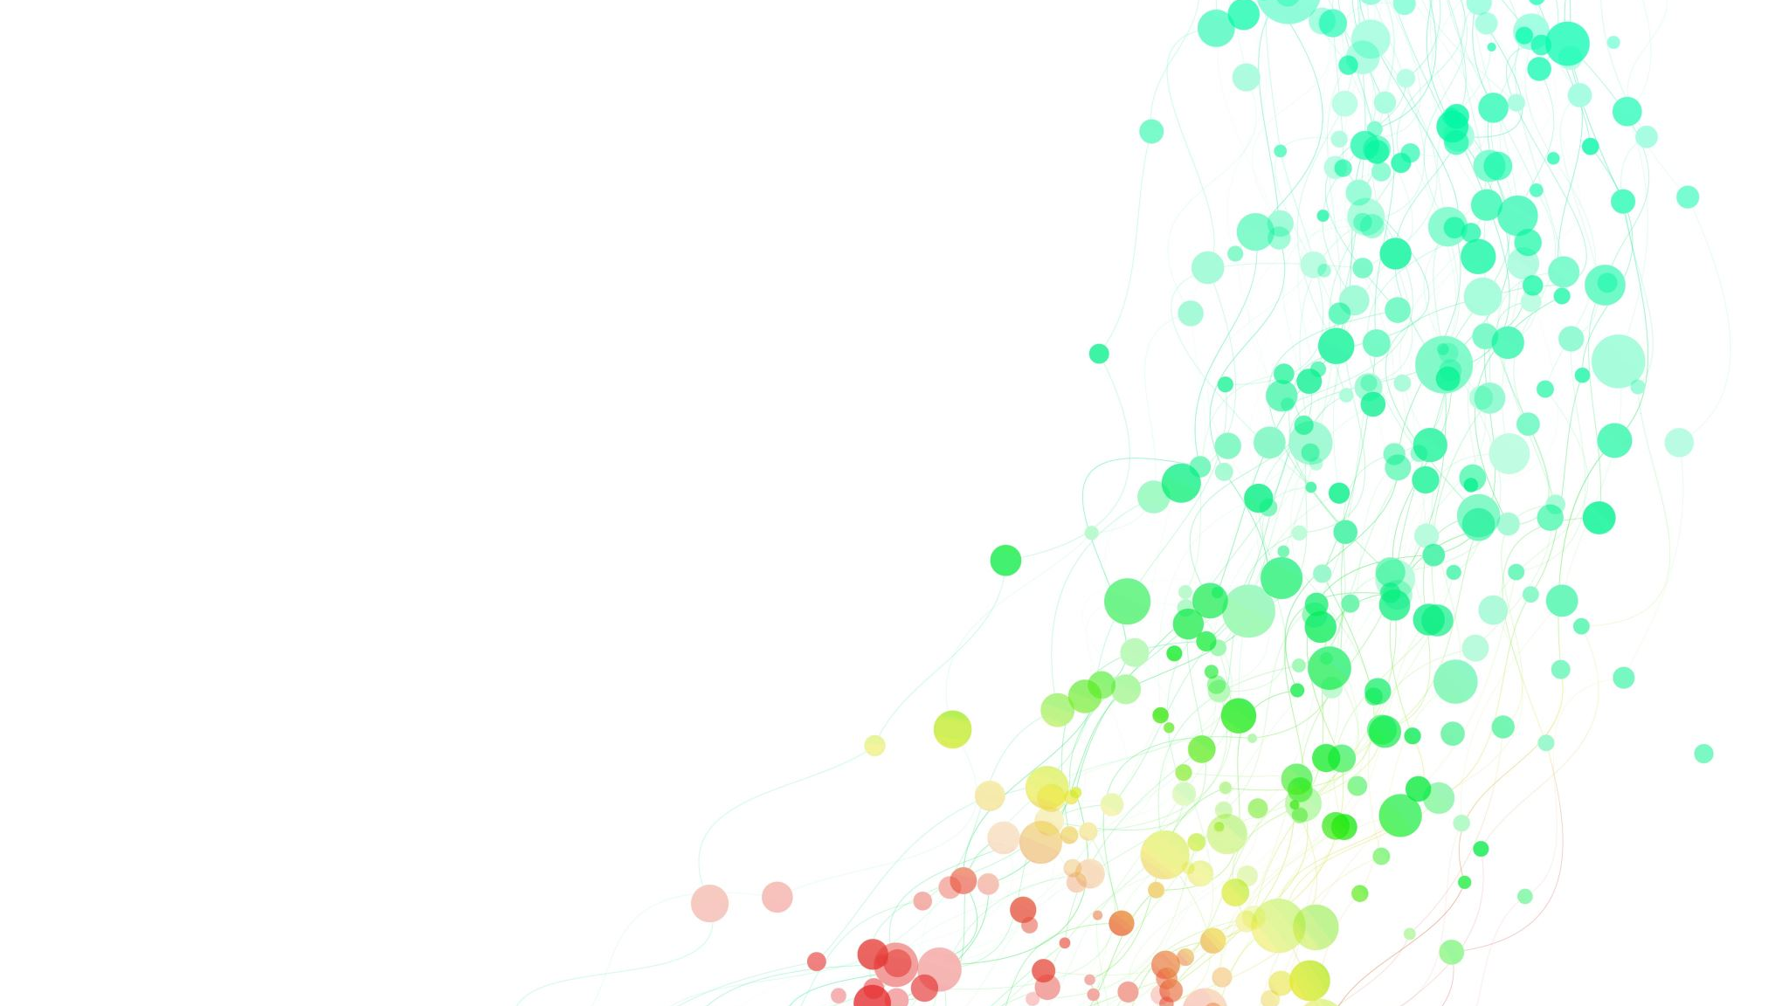
Ticketing Data Pipeline

Slide 2
The Problem
Lack of a unified data pipeline: Data from multiple sources (PostgreSQL, CSVs)
No centralized dashboard: Business teams lack a visualization tool
Limited insights into business performance

Slide 3
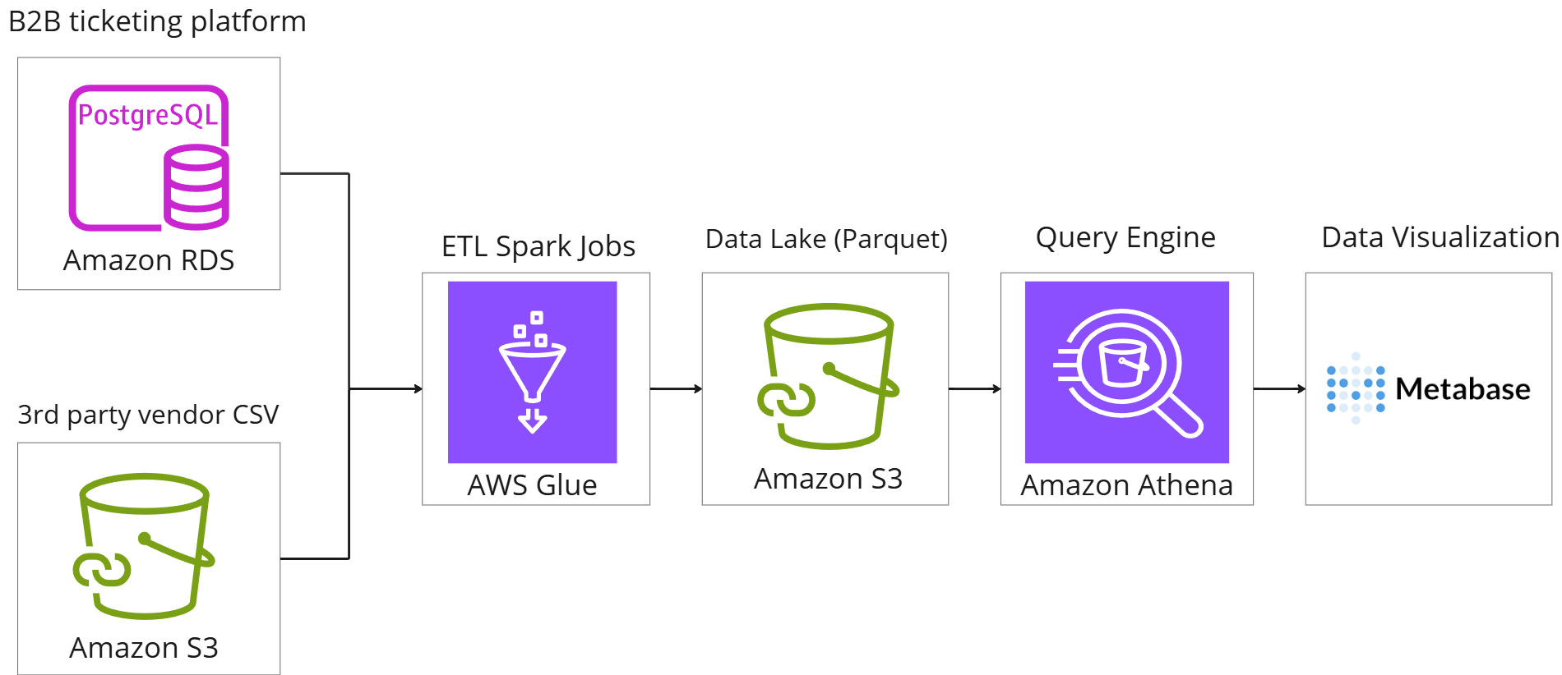
AWS Data Architecture
Monthly Cost: $80

Slide 4

Final Result
Link

